Slide 1


PROJECT
ATTENDANCE
AND
LEAVE
MANAGEMENT

Slide 2

Team- 5
Riya Yadav
Sanjana Gupta
Simran Pandey
Yuvraj Singh
Sanjeev Ranjan
Sankalp Maheshwari

Slide 3


Introduction
Welcome to our Attendance and Leave Management System. In today's fast-paced work environment, effective management of employee attendance and leave is paramount for organizational success. Our system represents a comprehensive solution designed to streamline and optimize these critical processes.
Purpose: Our system is developed to simplify the management of employee attendance and leave, ensuring accuracy, efficiency, and compliance with organizational policies and regulations.
Scope: Covering the entire spectrum of attendance and leave management, our system offers features for leave request submission, approval workflows, attendance tracking, reporting, and analytics.
Technology Stack: Built on the robust MVC.NET framework, our system leverages modern technologies to provide a scalable, reliable, and user-friendly solution.
Benefits: By automating manual tasks and providing real-time insights into workforce attendance, our system empowers organizations to make informed decisions, improve productivity, and enhance employee satisfaction.
Your Title

Slide 4
ABSTRACT OF THE PROJECT
Attendance & Leave Management System is an application, which develops a user interface for Attendance & Leave Management for maintaining employee’s leaves records.
It provides provision for employees to mark their attendance & leaves and it should also help users to track the status of their remaining leaves.
Managers can approve /reject the leaves and view the overall leaves taken by the employee in a month and year or between the selected days.
As per the employee grade, employee is eligible to get the credit of specific amount of leaves on the first date of every month.

Slide 5
OBJECTIVE
Development of Attendance & Leave Management System to automate the attendance and leave management of the employees.
Using ASP.NET MVC & Entity Framework
The application is mainly used by Admins, Managers and Employees.

Slide 6



User Roles
Admin
Manager
Employee
Role Assigned
Create Employee
Create Project
Leave Request Management
Attendance Tracking
Reporting and Analytics
User Authentication and Authorization
Mark Attendance
Request For leaves

Slide 7
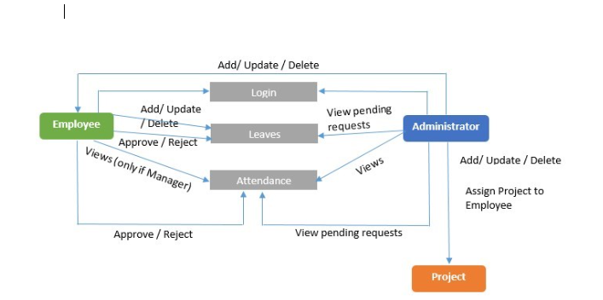
FLOW DIAGRAM

Slide 8
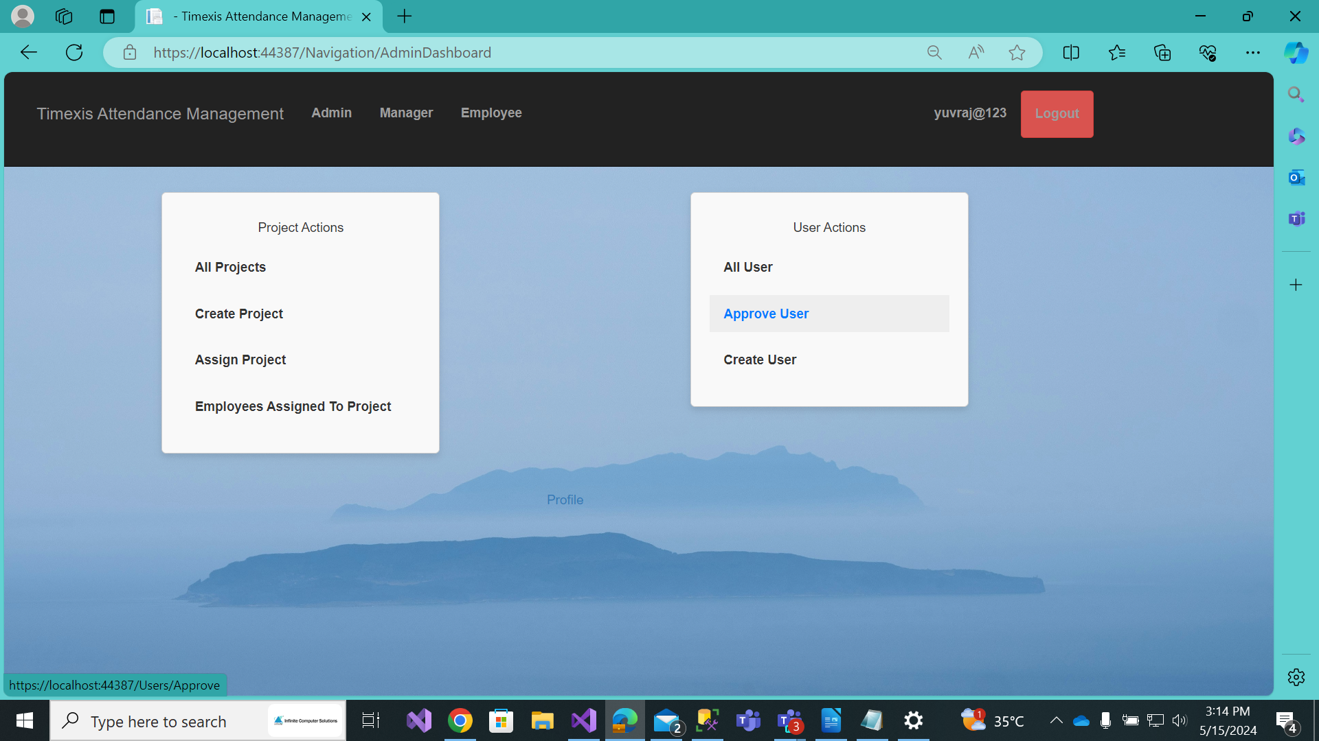
ADMIN DASHBOARD

Slide 9
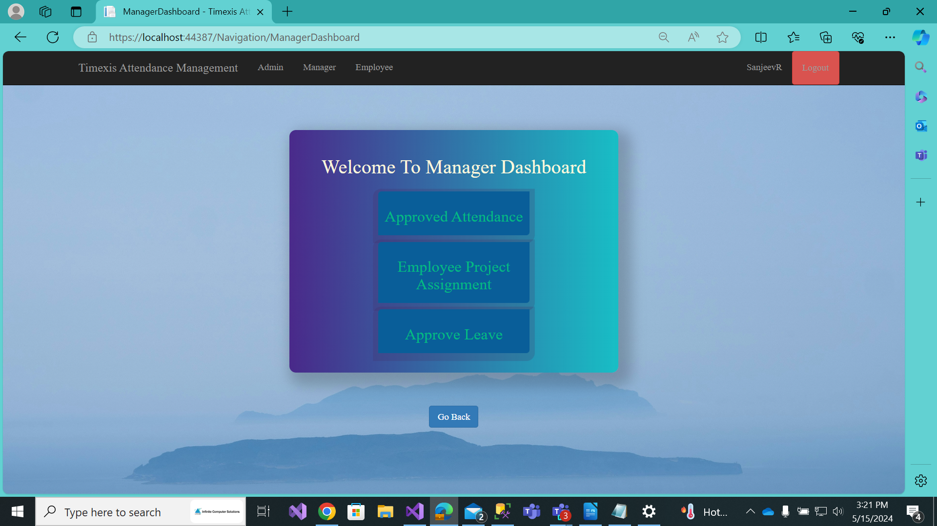

MANAGER DASHBOARD

Slide 10
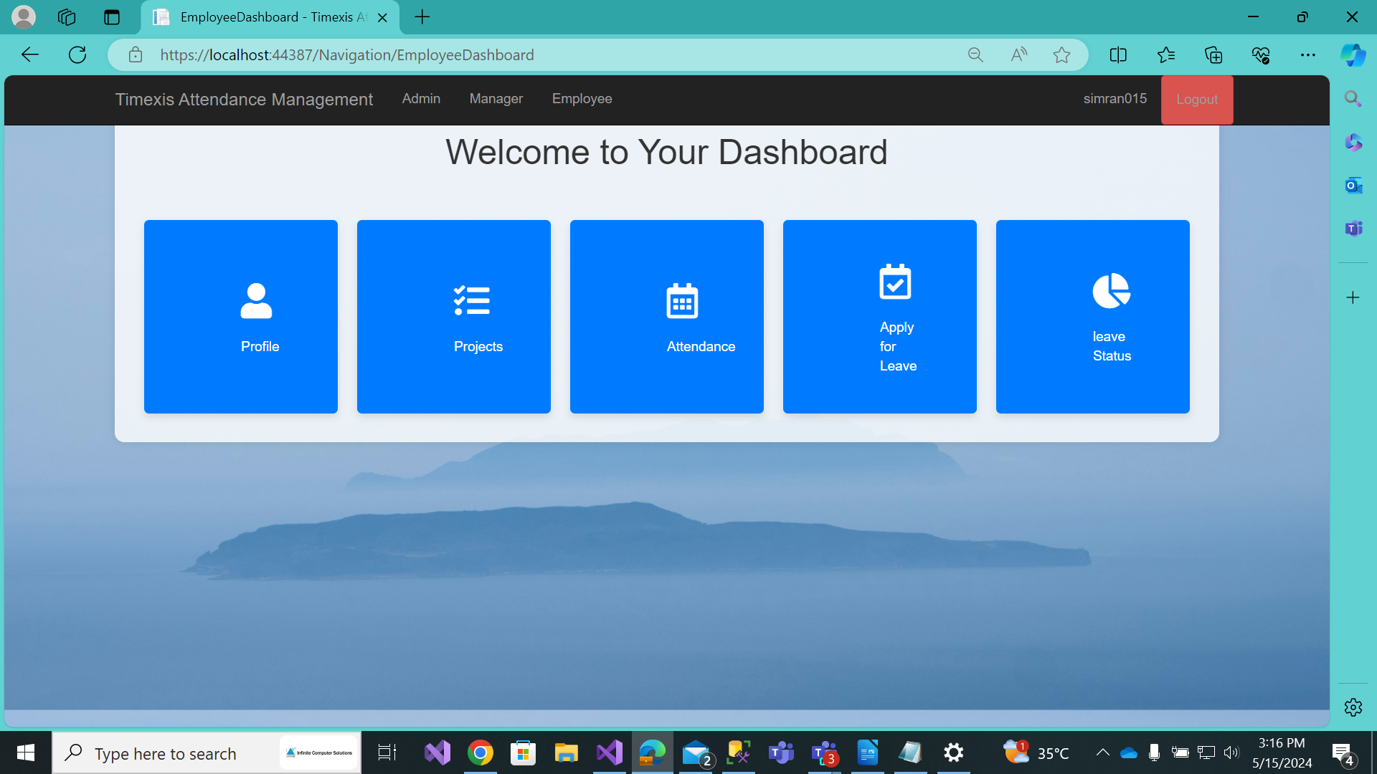
EMPLOYEE DASBOARD

Slide 11

THANK YOU

